Slide 1
SQL Server
Vivek Gohil

Slide 2
What is SQL Server
SQL Server is a relational database management system, or RDBMS, developed and marketed by Microsoft.
Similar to other RDBMS software, SQL Server is built on top of SQL, a standard programming language for interacting with the relational databases.
SQL server is tied to Transact-SQL, or T-SQL, the Microsoft’s implementation of SQL that adds a set of proprietary programming constructs.

Slide 3
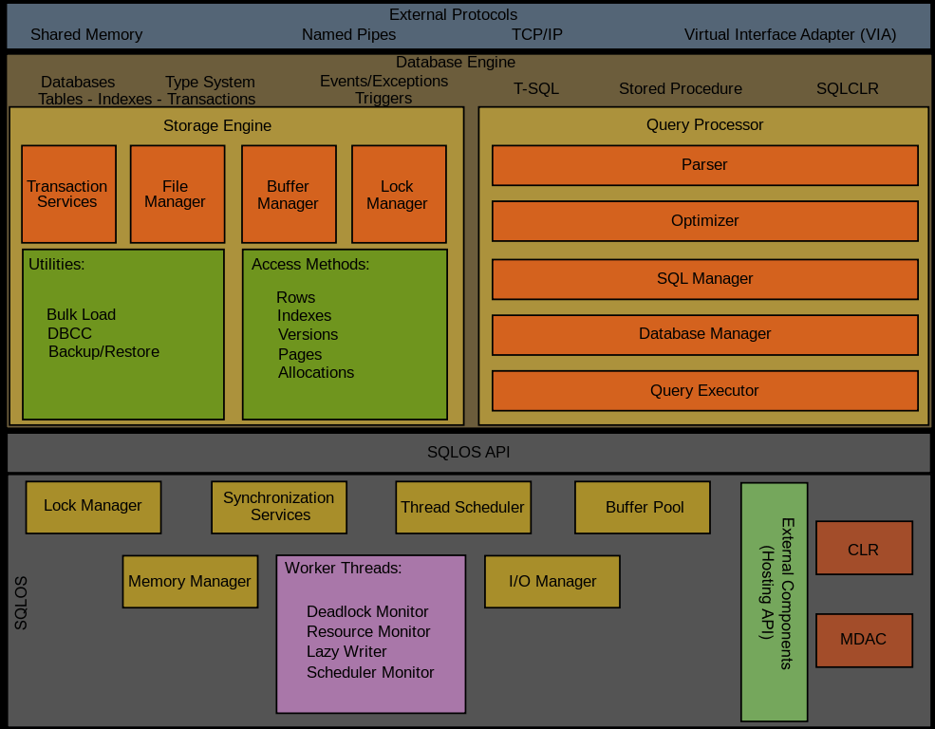
SQL Server Architecture

Slide 4
SQL Server Architecture
SQL Server consists of two main components:
Database Engine
SQLOS

Slide 5
Database Engine
The core component of the SQL Server is the Database Engine.
The Database Engine consists of a relational engine that processes queries and a storage engine that manages database files, pages, pages, index, etc. The database objects such as stored procedures, views, and triggers are also created and executed by the Database Engine.

Slide 6
SQLOS
Under the relational engine and storage engine is the SQL Server Operating System or SQLOS.
SQLOS provides many operating system services such as memory and I/O management. Other services include exception handling and synchronization services.

Slide 7
Connect to the SQL Server using SSMS
launch the Microsoft SQL Server Management Studio from the Start menu
from the Connect menu under the Object Explorer, choose the Database Engine

Slide 8
Execute a query
select @@version;

Slide 9
SQL Server Sample Database
in this training , we will use a SQL Server sample database called BikeStores.
BikeStores Sample Database - create objects.sql – this file is for creating database objects including schemas and tables.
BikeStores Sample Database - load data.sql – this file is for inserting data into the tables
BikeStores Sample Database - drop all objects.sql – this file is for removing the tables and their schemas from the sample database. It is useful when you want to refresh the sample database.

Slide 10
Load Sample Database
Right-click the Databases node in the Object Explorer and select the New Database
Enter the Database name as BikeStores and click the OK button to create the new database
If everything is fine, you will see the database BikeStores appears under Databases node.
From the File menu, choose Open > File… menu item to open a script file.
Select the BikeStores Sample Database – create objects.sql file and click the Open button
Click the Execute button to execute the SQL script.

Slide 11
Section 1. Querying data
This section helps you learn how to query data from the SQL Server database. We will start with a simple query that allows you to retrieve data from a single table.
SELECT – show you how to query data against a single table.

Slide 12
Section 2. Sorting data
ORDER BY – sort the result set based on values in a specified list of columns

Slide 13
Section 3. Limiting rows
OFFSET FETCH – limit the number of rows returned by a query.
SELECT TOP – limit the number of rows or percentage of rows returned in a query’s result set.

Slide 14
OFFSET and FETCH
In SQL Server OFFSET FETCH clauses to limit the number of rows returned by a query.
The OFFSET and FETCH clauses are the options of the ORDER BY clause. They allow you to limit the number of rows to be returned by a query.

Slide 15
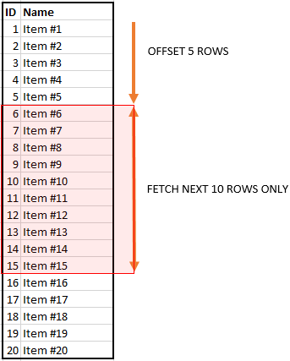
OFFSET and FETCH
The following illustrates the OFFSET and FETCH clauses

Slide 16
SELECT TOP
In SQL Server OFFSET FETCH clauses to limit the number of rows returned by a query.
The SELECT TOP clause allows you to limit the number of rows or percentage of rows returned in a query result set.

Slide 17
Section 4. Filtering data
DISTINCT – select distinct values in one or more columns of a table.
WHERE – filter rows in the output of a query based on one or more conditions.
AND – combine two Boolean expressions and return true if all expressions are true.
OR– combine two Boolean expressions and return true if either of conditions is true.
IN – check whether a value matches any value in a list or a subquery.
BETWEEN – test if a value is between a range of values.
LIKE – check if a character string matches a specified pattern.
Column & table aliases – show you how to use column aliases to change the heading of the query output and table alias to improve the readability of a query.

Slide 18
Section 5. Joining tables
Joins – give you a brief overview of joins types in SQL Server including inner join, left join, right join and full outer join.
INNER JOIN – select rows from a table that have matching rows in another table.
LEFT JOIN – return all rows from the left table and matching rows from the right table. In case the right table does not have the matching rows, use null values for the column values from the right table.

Slide 19
Section 5. Joining tables
RIGHT JOIN – learn a reversed version of the left join.
FULL OUTER JOIN – return matching rows from both left and right tables, and rows from each side if no matching rows exist.
CROSS JOIN – join multiple unrelated tables and create Cartesian products of rows in the joined tables.
Self join – show you how to use the self-join to query hierarchical data and compare rows within the same table.

Slide 20
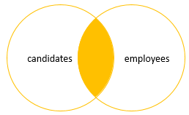
SQL Server Inner Join
Inner join produces a data set that includes rows from the left table which have matching rows from the right table.

Slide 21
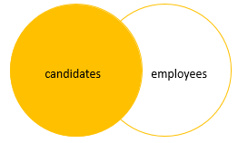
SQL Server Left Join
Left join selects data starting from the left table and matching rows in the right table. The left join returns all rows from the left table and the matching rows from the right table. If a row in the left table does not have a matching row in the right table, the columns of the right table will have nulls.
The left join is also known as left outer join. The outer keyword is optional.

Slide 22
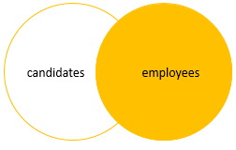
SQL Server Right Join
The right join or right outer join selects data starting from the right table. It is a reversed version of the left join.
The right join returns a result set that contains all rows from the right table and the matching rows in the left table. If a row in the right table that does not have a matching row in the left table, all columns in the left table will contain nulls.

Slide 23
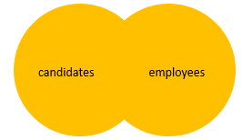
SQL Server full join
The full outer join or full join returns a result set that contains all rows from both left and right tables, with the matching rows from both sides where available. In case there is no match, the missing side will have NULL values.

Slide 24
SQL Server GROUP BY

Slide 25
Section 6. Grouping data
GROUP BY– group the query result based on the values in a specified list of column expressions.
HAVING – specify a search condition for a group or an aggregate.

Slide 26
Section 7. Subquery
Subquery – explain the subquery concept and show you how to use various subquery type to select data.
Correlated subquery – introduce you to the correlated subquery concept.
EXISTS – test for the existence of rows returned by a subquery.
ANY – compare a value with a single-column set of values returned by a subquery and return TRUE the value matches any value in the set.
ALL – compare a value with a single-column set of values returned by a subquery and return TRUE the value matches all values in the set.

Slide 27
Section 8. Data definition
CREATE DATABASE – show you how to create a new database in a SQL Server instance using the CREATE DATABASE statement and SQL Server Management Studio.
DROP DATABASE – learn how to delete existing databases.
CREATE SCHEMA – describe how to create a new schema in a database.
DROP SCHEMA – learn how to delete a schema from a database.

Slide 28
Section 8. Data definition
CREATE TABLE – walk you through the steps of creating a new table in a specific schema of a database.
Identity column – learn how to use the IDENTITY property to create the identity column for a table.
Sequence – describe how to generate a sequence of numeric values based on a specification.
ALTER TABLE ADD column – show you how to add one or more columns to an existing table

Slide 29
Section 8. Data definition
ALTER TABLE ALTER COLUMN – show you how to change the definition of existing columns in a table.
ALTER TABLE DROP COLUMN – learn how to drop one or more columns from a table.
Computed columns – how to use the computed columns to resue the calculation logic in multiple queries.
DROP TABLE – show you how to delete tables from the database.

Slide 30
Section 8. Data definition
TRUNCATE TABLE – delete all data from a table faster and more efficiently.
SELECT INTO – learn how to create a table and insert data from a query into it.
Rename a table – walk you through the process of renaming a table to a new one.
Temporary tables – introduce you to the temporary tables for storing temporarily immediate data in stored procedures or database session.

Slide 31
Section 9. Constraints
Primary key – explain you to the primary key concept and show you how to use the primary key constraint to manage a primary key of a table.
Foreign key – introduce you to the foreign key concept and show you use the FOREIGN KEY constraint to enforce the link of data in two tables.
NOT NULL constraint – show you how to ensure a column not to accept NULL.
CHECK constraint – walk you through the process of adding logic for checking data before storing them in tables.

Slide 32
Section 10. SQL Server Stored Procedures
Getting started with SQL Server Stored Procedures
A basic guide to stored procedures – show you how to create, execute, modify, and drop a stored procedure in SQL Server.
Parameters – learn how to create stored procedures with parameters, including optional parameters.
Variables – introduce you to Transact-SQL variables and how to manipulate variables in stored procedures.
Output Parameters – guide you on how to return data from a stored procedure back to the calling program using the output parameters.

Slide 33
Section 10. SQL Server Stored Procedures
BEGIN…END – create a statement block that consists of multiple Transact-SQL statements that execute together.
IF ELSE – execute a statement block based on a condition.
WHILE – repeatedly execute a set of statements based on a condition as long as the condition is true.
BREAK – exit the loop immediately and skip the rest of the code after it within a loop.
CONTINUE – skip the current iteration of the loop immediately and continue the next one.

